Slide 1

Protocol Design Considerations
Bruno Rijsman
Version 1, Presented at QuTech (Delft) on 22 November 2019

Slide 2
A few true stories…

Slide 3
Designing correct protocols is hard
On 27 October 1980, all routers in the entire Internet had to be rebooted simultaneously to recover from a protocol design weakness.
http://www.hannaypublications.com/portfolio/wp-content/uploads/2016/02/AppliedComms_A2.pdf

Slide 4
Version numbers to pick newest message
Message
Version number 8
<
Message
Version number 40
<
Message
Version number 44
Oldest version
Newest version
Note: this mechanism is still used today, for example in OSPF and ISIS link state flooding

Slide 5
Modulo 64 comparison creates ”version loop”
Message
Version number 8
44 < 8
(modulo 64)
8 < 40
(modulo 64)
Message
Version number 44
Message
Version number 40
40 < 44
(modulo 64)
Version field was unsigned 6-bit integer, so math is modulo 64
Competing message versions kept replacing each other forever, eating up all CPU
The versions were introduced to a double bit error, which was not detected because check-sums were disabled.

Slide 6
We have not quite yet learned our lessons
A similar problem exists in the BGP specification and is observed in the Internet to this day.
See BGP persistent route oscillations (RFC3345)

Slide 7
Implementing protocols correctly is hard
A bug in a widely used BGP implementation allowed an attacker to advertise a BGP route that caused many BGP routers on the other side of the world to crash.
Sending a specially constructed 4-octet AS-path caused certain routers to crash CVE-2014-3818 https://securitytracker.com/id/1031009

Slide 8
Protocol security is hard
A BGP vulnerability enabled hackers to rob a bitcoin bank.
https://www.wired.com/2014/08/isp-bitcoin-theft/

Slide 9
Planning for evolution Multi-version, multi-feature, multi-vendor networks

Slide 10
Your protocol will evolve over time
Typical versioning scheme:
Minor version bump = backwards compatible
Major version bump = not backwards compatible
In practice, this does not work!
Examples of doing it wrong:
IPv4 to IPv6
OSPFv2 to OSPFv3
Examples of doing it right
ISIS
BGP
Evolve features without breaking backwards compatibility
If you don’t design your protocol with the future in mind, every new feature will be a major version bump…

Slide 11

The problem with major version bumps
It’s extremely hard avoiding running different major versions in your network if major bumps happen frequently.
Temporarily during upgrade. You cannot upgrade your devices all at once; it takes a lot of time.
Or semi-permanently due to operational considerations (e.g. different vendors support different versions of the protocol). You want to be able to have multiple vendors in the same network.
Your network will be partitioned. Having a partitioned network makes finishing the upgrade nearly impossible.
Version 1.0
Version 2.0
Version 1.0
Version 1.1
Version 3.0
Partitions

Slide 12
A better approach based on features
Protocol implementation that has feature A must interoperate with protocol implementation that does not have feature A.
Different vendors and versions of code have different feature sets.
Don’t assume the feature set can be derived from the protocol version. Allows protocol extensions to evolve and be deployed independently.
Don’t assume the feature set is the same. Feature set A+B must interoperate with B+C.
A
D
B
C
C
D
A
B
D
A
B
C
Protocol features (aka capabilities)
A
B
C
D

Slide 13
Capability announcement (“negotiation”)
A
B
C
B
C
D
I support features A, C, D
I support features B, C, D
We can use features B, C (these are the ones we have in common)
We can use features B, C (these are the ones we have in common)
(Things get a bit more complicated when more than 2 devices are involved, e.g. flooding)

Slide 14
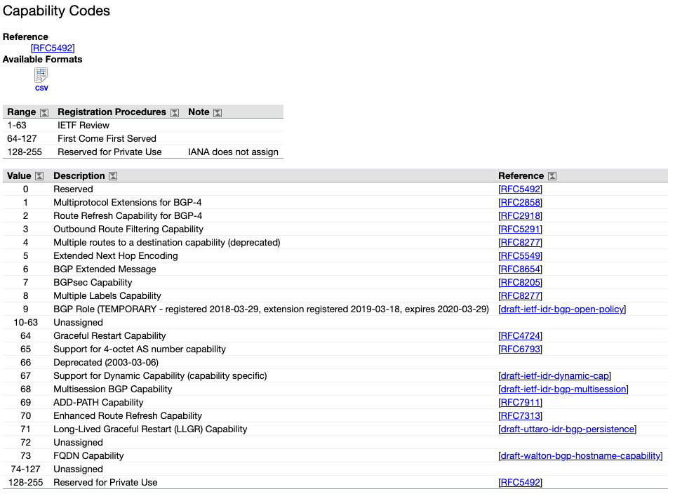
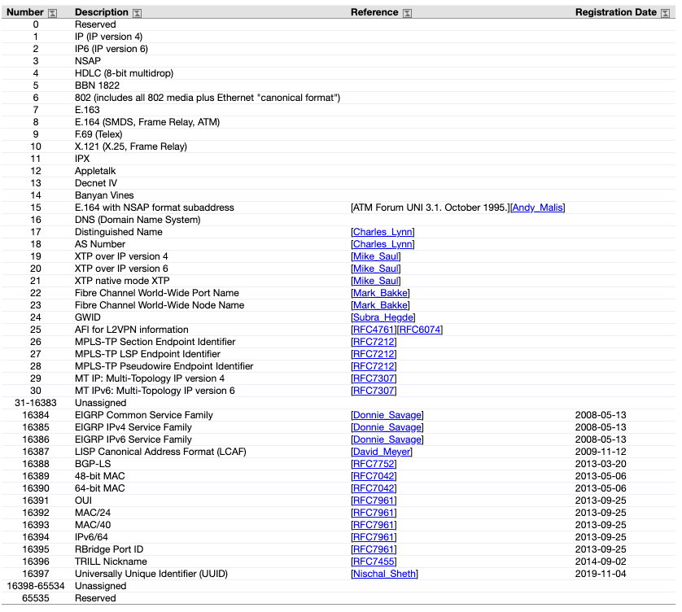
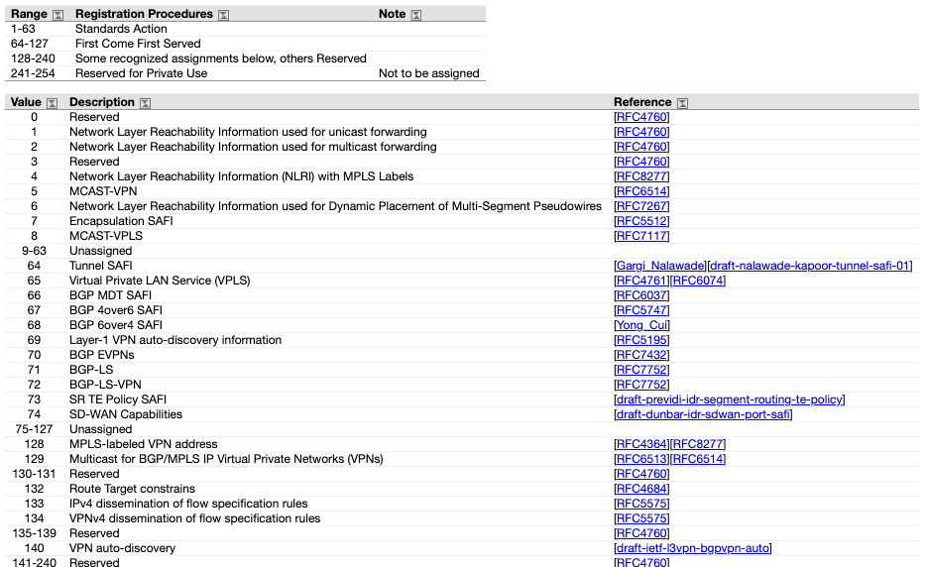
Example: BGPv4 capabilities

Slide 15
Type Length Value (TLV) Encoding
Makes it easy for old versions of the protocol to interoperate with new versions of the protocol.
Also avoid bugs in the code by making it easier to write parsers.
Used in almost all modern protocols (OSPF, ISIS, BGP, RSVP, …)

Slide 16
Type Length Value (TLV) Encoding
How many bytes?
Type code
Length
Value
What does it mean?
Very easy to parse; less chance of bugs in parses.

Slide 17
Hierarchical TLVs
Type
Length
Value
Type
Length
Value
Type
Length
Value
TLVs
Sub-Type
Length
Value
Sub-Type
Length
Value
Sub-TLVs
Sub-Sub-Type
Length
Value
Sub-Sub-Type
Length
Value
Sub-Sub-TLVs

Slide 18
Easy to skip unknown TLVs
Can parse and act on values
Known types
Type
Length
Value
Type
Length
Value
Type
Length
Value
Don’t know how to parse this or act on it
Enables receiver to skip and ignore the unknown value
(but is that the right thing to do?)
Unknown type (unknown feature, future version of protocol, ..)

Slide 19
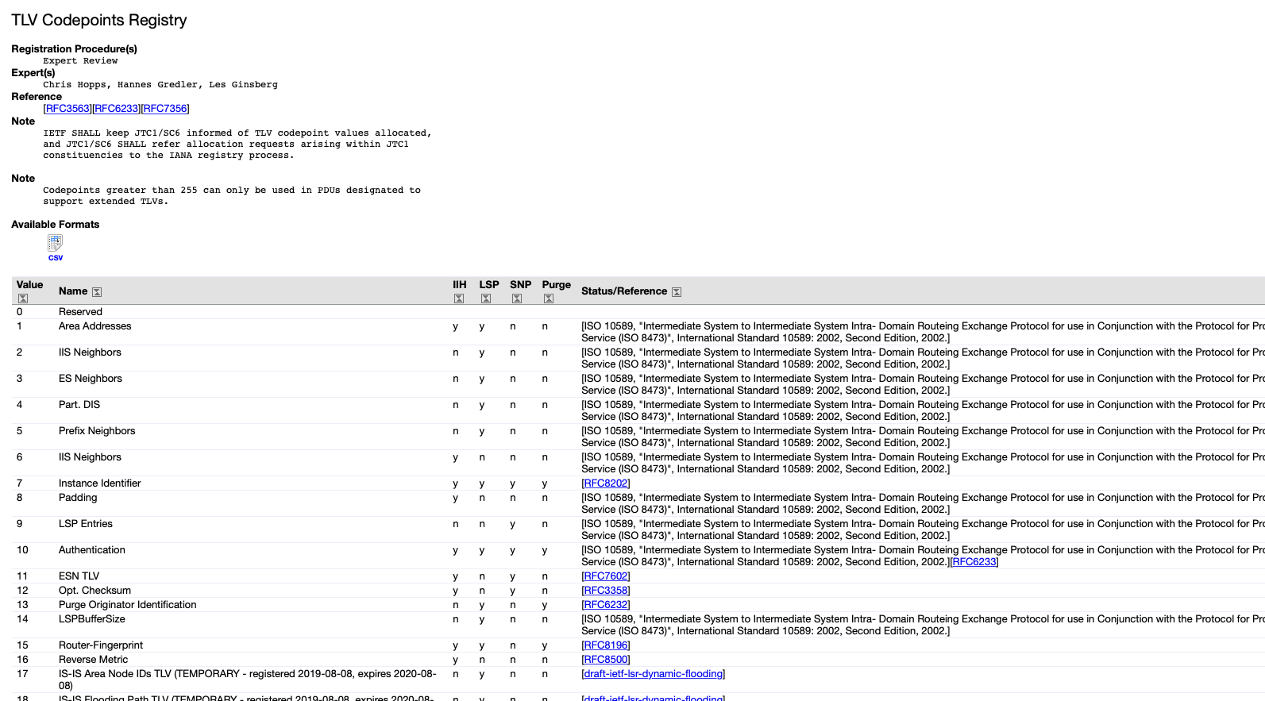
Example: IANA ISIS TLV code point registry

Slide 20
How to handle unrecognized TLVs?
What should you do when you receive a TLV with an unknown type?
Happens when another device is running a newer version of the protocol.
Options:
Ignore and propagate the TLV
Ignore and remove the TLV
Declare an error
Note: ignoring is possible because the length L is known and the value can be skipped
The originator of the TLV (who by definition understands it) sets some extra bits in the TLV to instruct the receiver what to do.

Slide 21
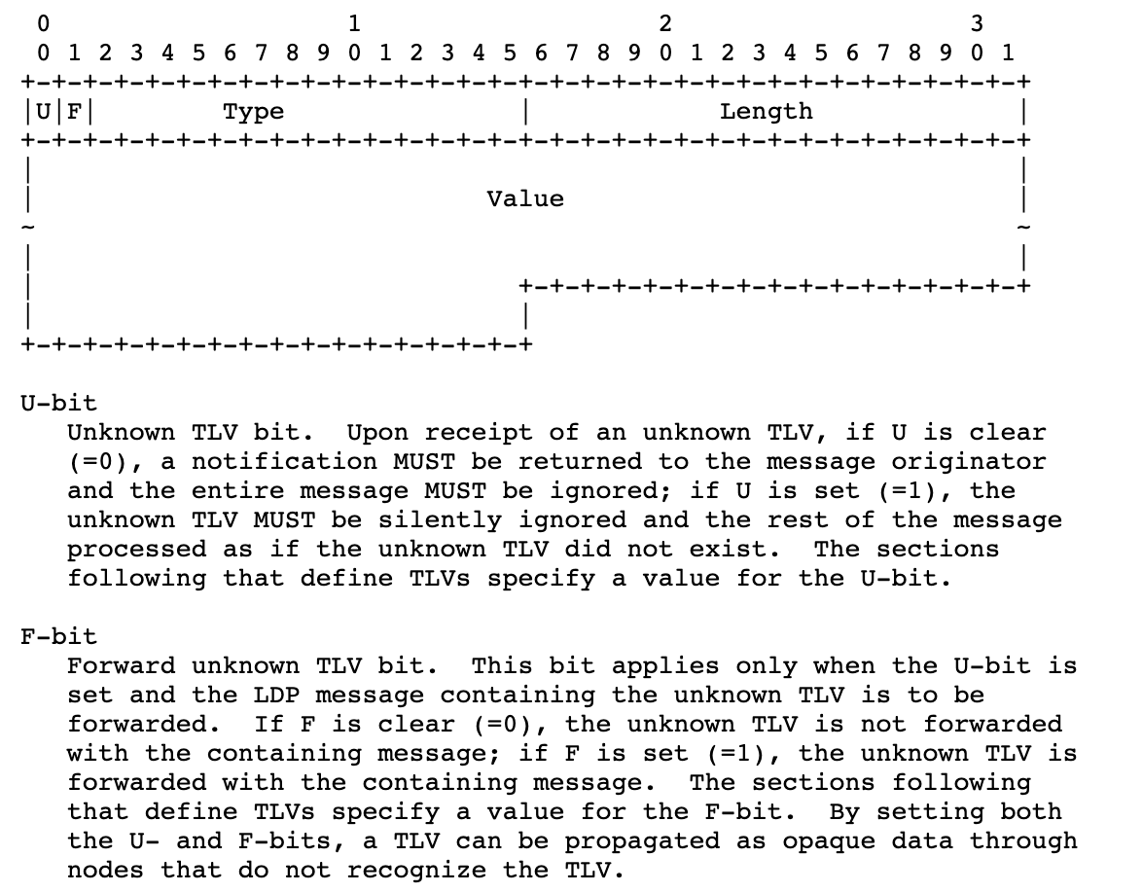
Example: Label Distribution Protocol (LDP)
TLV encoding is also used in:
BGP
OSPF
ISIS
RSVP
Many more…

Slide 22
Beyond TLVs: formal modeling languages
Protocol message data model
Abstract syntax: ASN1, YANG, GPB
Modeling language compiler
Protocol implementation
Protocol implementation
Generated code for
encoding and decoding messages Local syntax: Rust objects
Generated code for
encoding and decoding messages
Local syntax: Python objects
Encoded message on the wire
BER, CER, NETCONF, RESTCONF, GPB

Slide 23
Examples
Modeling language | Protocols
ASN.1 | Simple Network Management Protocol (SNMP)
ASN.1 | Light-weight Directory Access Protocol (LDAP)
YANG | Network Configuration Protocol (NETCONF)
Protobuf | GRPC Network Management Interface (gNMI)
Thrift | Routing In Fat Trees (RIFT)

Slide 24
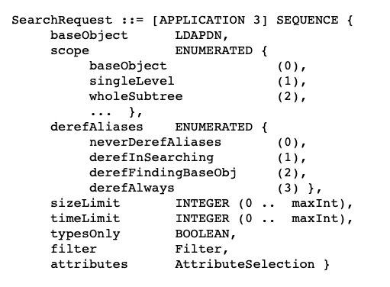
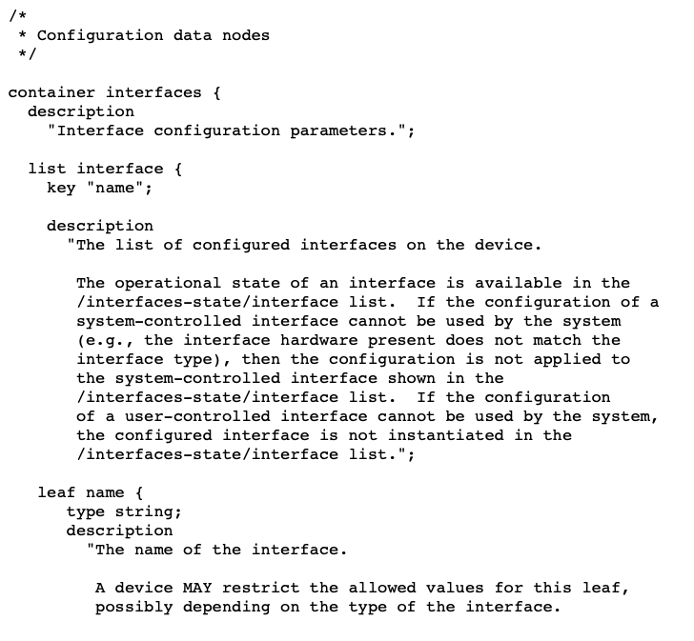
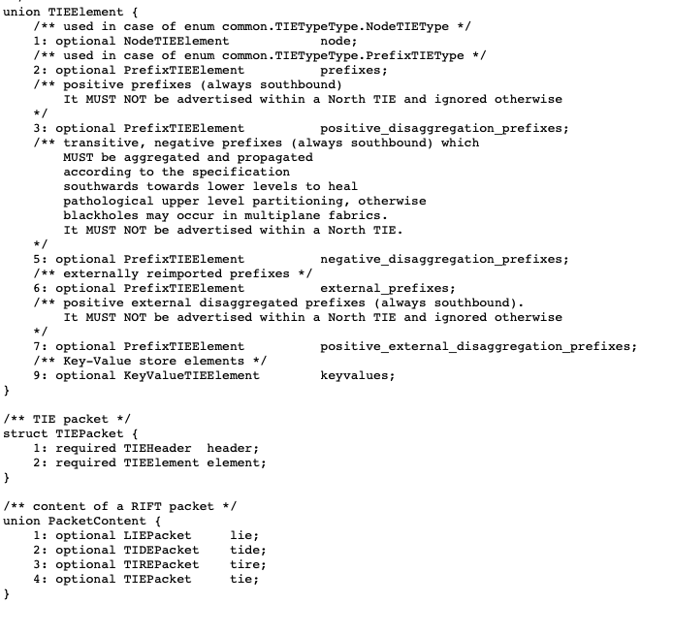
Examples
ASN.1 model for LDAP protocol
YANG model for interface management
Thrift model for RIFT protocol

Slide 25
Control protocol security

Slide 26
Control plane security
Authentication
Is the router that I am talking to really the router it claims to be?
Integrity
Are the routing messages modified or spoofed by an adversary?
Special case: replay attack
Confidentiality?
Encrypt the protocol messages (often not a requirement)
Authorization
Is this router allowed to have an adjacency with me?
Is this router allowed to advertise this route?
If it originates the route, can it prove it owns the prefix?
If it propagated the route, can it prove that the advertised path is correct?

Slide 27
Neighbor authentication and integrity
Pre-shared key configured on each router
Sign each message with secure hash using pre-shared key
Add sequence number to prevent replay attacks
Message often not encrypted
Protocol
Message
Pre-shared key
Sender increases
Receiver checks increasing
Sequence nr
Secure hash function
Signature

Slide 28
Link state flooding: origin and outer key
A
B
C
D
Link State
Flooded by A
Link State
Flooded by A
Link State
Flooded by A
Origin Signature
Signed by A
Origin Signature
Signed by A
Origin Signature
Signed by A
Sequence Nr
Added by A
Sequence Nr
Added by B
Sequence Nr
Added by C
Outer Signature
Signed by A
Outer Signature
Signed by B
Outer Signature
Signed by C
Every router in the networks must have the same pre-shared origin key (not feasible for IDR)
Pre-shared outer keys can be different per link, but are the same in practice
Pre-shared key roll-over is very painful; often does not happen in practice

Slide 29
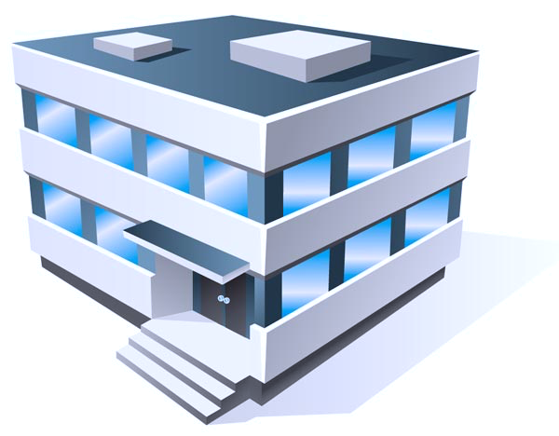
BGP prefix hijacking
Internet Registry (IR)
BGP UPDATE
Prefix: 1.1.1.0/24
AS-Path: 101 102 103
BGP UPDATE
Prefix: 1.1.1.0/24
AS-Path: 102 103
BGP UPDATE
Prefix: 1.1.1.0/24
AS-Path: 103
Assign:
AS 103
Address 1.1.1.0/24
AS 100
AS 101
AS 102
AS 103
AS 104

Slide 30
BGP prefix hijacking
Internet Registry (IR)
BGP UPDATE
Prefix: 1.1.1.0/24
AS-Path: 101 102 103
BGP UPDATE
Prefix: 1.1.1.0/24
AS-Path: 102 103
BGP UPDATE
Prefix: 1.1.1.0/24
AS-Path: 103
Assign:
AS 103
Address 1.1.1.0/24
AS 100
AS 101
AS 102
AS 103
BGP UPDATE
Prefix: 1.1.1.0/24
AS-Path: 101 102 103
Accidental or malicious invalid BGP UPDATE
AS 104 does not own prefix 1.1.1.0/24
AS 104

Slide 31
BGP route origin authentication (ROA) (Simplified)
Internet Registry (IR)
ROA
AS 701
Block 100.1.0.0/16
Signed by IR
Assign:
AS number: 701
Address block: 100.1.0.0/16
Public Repository
Validate signature
and cache ROA
Validator
aka validating cache
Validator
BGP UPDATE
Prefix: 100.1.0.0/16
AS-Path: 701
BGP UPDATE
Prefix: 100.1.0.0/16
AS-Path: 2686 701
Check each received
UPDATE
Autonomous System 701
Autonomous System 2686
Autonomous System 286

Slide 32
Also need BGP path validation
Provider X
Provider Y
A
A
Customer A
Customer B
Customer C
Accidental violation of valley-fee routing
Y should not do transit through customer B
B should not advertise A to Y
Y should not accept A from B
(There are also malicious flavors of this, e.g. BGP poisoning)

Slide 33
Upgrades, crashes There is no maintenance window for the Internet

Slide 34
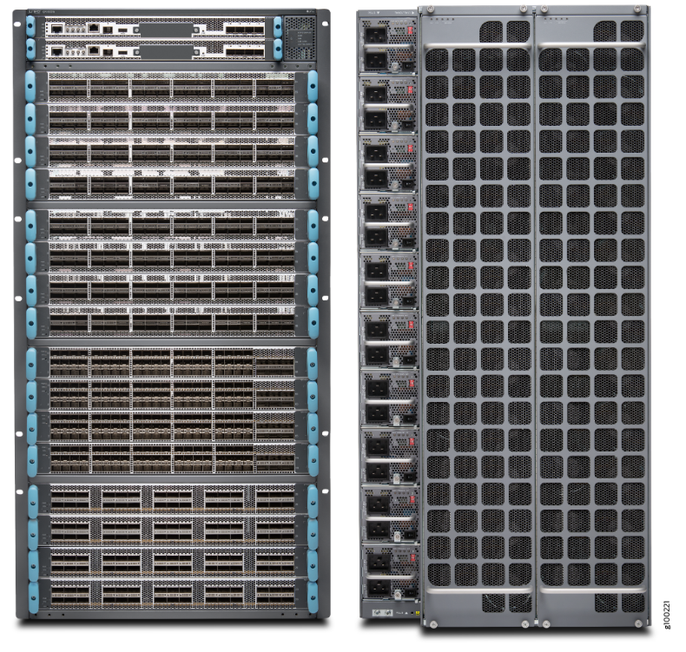
Chassis devices
Redundant control planes (routing engines)
Everything (routing engine, switch fabric, power supplies, fans, …) redundant and in-service replaceable

Slide 35
In-Service Software Upgrade (ISSU)
Active routing engine
Version 1
Active routing engine
Version 1
Active routing engine
Version 1
Active routing engine
Version 2
Standby routing engine:
Version 1
Standby routing engine:
Version 2
Standby routing engine:
Version 2
Standby routing engine:
Version 2
Forwarding engine
Forwarding engine
Forwarding engine
Forwarding engine
Forwarding engine
Forwarding engine
Forwarding engine
Forwarding engine
Upgrade
standby
Switch-over
Upgrade
new standby

Slide 36
Non-Stop Forwarding (NSF) Also known as Graceful Restart (GR)
Control-plane session
PREPARE FOR RESTART
Control-plane session PREPARE FOR RESTART
Active routing engine: version 1
Standby routing engine: version 2
Data-plane traffic
Forwarding engine
Data-plane traffic
Active routing engine: version 1
temporarily
NO control plane session
temporarily
NO control plane session
Standby routing engine: version 2
Data-plane traffic
Forwarding engine STALE TABLES
Data-plane traffic
Active routing engine: version 1
Control-plane session
RESYNCHRONIZE
Standby routing engine: version 2
Control-plane session RESYNCHRONIZE
Data-plane traffic
Data-plane traffic
Forwarding engine

Slide 37
Non-Stop Routing (NSR)
Control-plane session
Active routing engine: version 1
Control-plane session
Standby routing engine: version 2
Data-plane traffic
Forwarding engine
Data-plane traffic
Switchover a LIVE control plane session (TCP connection)
Incredibly difficult; requires constant synchronization of TCP state
Cause more problems than it solves in real life.
Modern approach: use scale-out instead of scale-up (when possible)
Active routing engine: version 1
Control-plane session
Standby routing engine: version 2
Control-plane session
Data-plane traffic
Data-plane traffic
Forwarding engine

Slide 38
Pizza-box devices
Does not have redundant routing hardware routing engines.
(Sometimes in redundant software routing engines using virtual machines or containers.)
Cheap commodity hardware

Slide 39
Scale-out instead of scale-up
Scale-up
One large chassis switch
Internal switch fabric
If switch fails, all is lost
NSF or NSR for upgrade
Everything must be redundant
Expensive
Complex
Scale-out
Multiple small pizza-box switches
Clos fabric
If one switch fails, only 1/N^{th} of capacity lost
Rolling upgrade
No redundancy needed inside switch
Cheap
Simple

Slide 40
Flow control Congestion control Error control in the data plane

Slide 41
Flow control
Make sure the sender does not produce data faster
than the receiver can consume it.
Consume 3 pps
Send 5 packets per second (pps)
Receive buffer overflows.
Buffer can absorb bursts but not sustained rate difference.
Drop 2 pps
Note: here it is the receiver that is not keeping up; the network can keep up fine.

Slide 42
Flow control in quantum network
Make sure sender does not produce qubits faster
than receiver can consume them.
Bell pair
Ideally, it is produced “fresh” just before we have a qubit to teleport
Qubit that has been teleported
Receiver needs to store it in memory until it is consumed (measured)
Qubit to be teleported
Sender never stores more than one “qubit to be sent” in memory
Consumer can run out of qubit memory ifs sender sends qubits
faster than received consumes (measures) them.
[Animation]

Slide 43
Flow control approaches
General principle: make the data arrive more slowly
Approach 1: Sliding window
Receiver makes the sender slow down by delaying permission to send
It is okay to receive data later (delay in-sensitive traffic)
Web pages, file transfer, e-mail, …
Approach 2: Adaptive encoding
The sender sends less data by switching to more lossy compression
It is not okay to receive data later (delay-sensitive traffic)
Voice, live video, video on demand, …
Related approach: Time slot scheduling
Used in Time Division Multiplexing (TDM) and wireless networks
Avoids congestion from happening in the first place
Sender must be able to back-pressure application

Slide 44
Sliding window
Window size = 5
Buffer size 5
Window size = 3
Window size = 0
Window size = 2
Consumed

Slide 45
Bandwidth-delay product
100 Gbps, 5000 km (= 50 ms round-trip @ speed of light in fiber)
window size 800 Mbit @
100 Gbps = 8 ms
Round-trip time 25 ms
Window size must be ≥ bandwidth * round-trip delay to fully utilize available bandwidth.
In this example window size (= receive buffer size) is 100 MB = 800 Mbit
Only 32% of available bandwidth is used.

Slide 46
Congestion
Make sure senders do not produce data faster
than network can carry it.
Send link-rate
Send link-rate
Try to send 2x link-rate traffic on link.
Transmit buffer overflows.
Drop half of traffic.

Slide 47
Congestion control
Congestion avoidance: avoid congestion in the first place
Congestion mitigation: deal with congestion when it does occur
Worst case scenario: congestive collapse
Effective capacity of the network to carry useful traffic drops to zero
Retransmissions due to excessive drops and queueing delays overwhelm network
More likely to happen when capacity is low compared to demand (as it will be in early quantum networks!)
This actually happened in the early internet: in 1986 the capacity collapsed from 32 Kbps to 40 bps (not Kbps) https://blog.acolyer.org/2015/05/21/congestion-avoidance-and-control/ https://tools.ietf.org/html/rfc896

Slide 48
Congestion avoidance
Congestion avoidance: mechanisms to avoid congestion in the first place
General principle: send traffic more slowly when congestion occurs
TCP congestion control
TCP tries to estimate maximum rate before congestion occurs
TCP sender dynamically congestion window based on presence or absence of drops
Extremely difficult to get right: Reno, Vegas, BIC, CUBIC, …. and many more algorithms
Assumes everyone plays fair
Backwards Explicit Congestion Notification (BECN)
Router sends message to source to slow down when it observes congestion
Forward Explicit Congestion Notification (FECN)
Set bits in forwarded IP packet: Congestion Encountered (CE)
Requires cooperation from the transport layer to slow down

Slide 49
Congestion mitigation
Active Queue Management (AQM):
Mechanism for dealing with congestion when it does occur
Queueing only happens if there is contention = congestion
Decide which packets are most important
Classification at the edge
Mark classification result into QoS / precedence bits in packet header
Decide which packet to service next in the send queue
Hierarchical schedulers
Shapers
Decide when to start dropping packets and which packet to drop
Tail-drop
Random Early Drop (RED)
Drop out-of-profile packet before in-profile packets

Slide 50
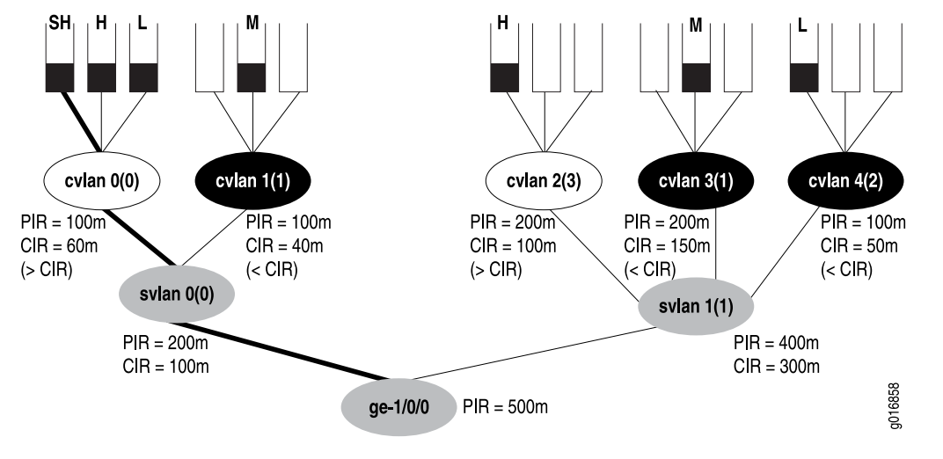
Hierarchical queue scheduler
Source https://www.juniper.net/documentation/en_US/junos/information-products/pathway-pages/cos/config-guide-hierarchical-cos.pdf

Slide 51
“Congestion control” in quantum networks
End-points cannot get more end-to-end Bell pairs per second (Bpps) than network can produce them
based on bottleneck link or router.
Desire X Bpps
10 Bpps
10 Bpps
10 Bpps
10 Bpps
10 Bpps
Desire Y Bpps
Bottleneck link.
Cannot achieve desired end-to-end entanglements if X+Y > 10
(or even less considering non-deterministic swaps and distillation)

Slide 52
Reliable transport: error detection and recovery
This is an example of the go-back-N error recovery
1
2
Ack 1
Time-out
waiting for akc-2
based on estimate RTT
Retransmit packets +
Adjust congestion window
Dropped
(most likely due to congestion)
3
4
2
Retransmit
3
Retransmit
Ack 2
4
Ack 3
Retransmit

Slide 53
Error detection and recovery mechanisms
Checksums
To detect transmission errors
Classical networks are so reliable that the vast majority of drops are due to congestion
Automatic Repeat Request (ARQ)
Receiver sends an acknowledgement (ack) when it has correctly received the data
The sender re-transmits the data when it does not receive the ack
Not an option for quantum networks (requires that the sender keeps a copy until the data is acknowledged, in case the data needs to be retransmitted).
Go-back-N: resend all data starting at the dropped packet
Selective repeat: only resend the data that was dropped (requires selective ack)
Forward Error Correction (FEC)
When error rate is too high (noisy links)
When retransmission is delay is not acceptable (e.g. long latency satellite links)
The only option in quantum networks (quantum error correcting codes)

Slide 54
What is so difficult about this?
Flow control, congestion control, and error control are separate but closely related concepts
Most transport protocols don’t have clean separation of concerns
For example, in TCP absence of ACK can mean many things:
Flow control: receiver wants us to slow down
Error: data packet or ACK was dropped
Congestion: data packet or ACK was delayed in queue
Over time TCP has been enhanced:
Selective acknowledgement (SACK)
Timestamps

Slide 55
Flow control Congestion control Error control in the control plane

Slide 56
Flow control matters in the control plane
Routing and signaling protocols exchange large volumes of data
Sender must not overwhelm receiver
Flow control approaches in routing and signaling protocols:
Fixed pacing
Flow control mechanism built into the protocol itself
Rely on TCP flow control

Slide 57
Example: ISIS flow control
Initial database synchronization sends large volume of link state packets (LSPs) Potentially tens of thousands of LSPs
IIH
ISIS adjacency comes up
LSP
Pacing parameters in standard, e.g. minimumLSPTransmissionInterval
Recent proposals to dynamically control intervals in ISIS protocol.
Initial link-state database (LSDB) synchronization

Slide 58
Example: BGP flow control
Initial database synchronization sends large volume of routes (UPDATEs) Often well above 1 million routes
OPEN
BGP session comes up
UPDATE
Initial route table (RIB) database synchronization
BGP relies on TCP for flow-control (and reliability for that matter)

Slide 59
Congestion control matters in the control plane
Control packets have strict priority over user packets
Large volume of control packets can still cause congestion
Congestive collapse of control protocols is not rare
Flapping ISIS adjacencies self-reinforcing feedback loop
Solutions:
Prioritize important control plane packets (mainly hellos)
Multiple streams (QUIC, SCTP)
Off-load liveness detection to separate protocol (BFD)

Slide 60
Error control matters in the control plane
Control plane packets also get dropped
Need reliability mechanism (error control) in routing and signaling protocols
Approaches:
Separate mechanism built-in to protocol itself: ISIS, OSPF, …
Rely on transport (TCP) for reliability: BGP, LDP, …

Slide 61
Example: ISIS error control
Partial Sequence Number PDU (PSNP) is used to ack LSP
There is also a Complete Sequence Number PDU (CSNP) that we don’t discuss here
LSP 1
LSP 2
PSNP acks LSP
PSNP 1 2
LSP 3
LSP 4
Time-out
PSNP 4
LSP is transmitted if ack is not received
LSP 3
PSNP 3

Slide 62
Take-aways for quantum control protocols
You need to worry about flow control
You need to worry about congestion control
You need to worry about error control
Not just in the data plane, but also in the control plane
Avoid re-inventing the wheel: rely on layer 4 transport when possible This is somewhat contentious; it is my opinion that not everyone agrees with.

Slide 63
Soft state versus hard state

Slide 64
Soft state vs hard state
Sender wants to advertise some data (e.g. a route) to receiver.
Soft state protocol
A.k.a. Periodic protocol
Sender initially sends data.
Receiver puts data in its database.
Sender periodically resends data (refresh).
If receiver doesn’t receive data anymore, it removes data from its database after time-out.
Heavy load due to periodic transmission.
Fallacy: simpler cleanup when sender crashes.
Hard state state protocol
Runs protocol over reliable transport connection.
Sender initially sends data.
Receiver puts data in its database.
No periodic re-transmissions of data.
Receiver keep data in database until (a) sender explicitly withdraws data or (b) transport connection is disconnected.
No traffic if no changes in the database.
Needs reliable transport connection and keep-alive mechanism (typically TCP)

Slide 65
Example: soft state in RSVP
PATH
PATH
PATH
Refresh interval
(~ 45 seconds)
RESV
RESV
RESV
PATH-refresh
PATH-refresh
PATH-refresh
RESV-refresh
RESV-refresh
RESV-refresh
PATH-refresh
PATH-refresh
PATH-refresh
RESV-refresh
RESV-refresh
RESV-refresh

Slide 66
The problem with soft state
Typical network topology
Core router
Edge router Dual-homed to core router

Slide 67
The problem with soft state
Typical network topology
Core router
Edge router Dual-homed to core router
Full mesh of LSPs From every edge router to every other edge router Traffic engineered according to bandwidth-demand matrix This diagram show logical topology of LSPs (not physical topology)

Slide 68
The problem with soft state
Core router
Number of LSPs is O(N²)
When N is number of edge routers
Refresh frequency is O(N²)
Real-life example
Number of edge routers: 500
Number of LSPs: 500*499 = 249,500
Refresh interval = 45 seconds
Refresh traffic: 11,088 messages/sec (Simplifying assumption that all LSPs pass through the same core router)
This is not feasible in the control plane

Slide 69
Example: hard state in BGP
UPDATE
UPDATE
UPDATE
UPDATE creates hard state
Can be > 1 million routes
Periodic refresh not feasible
Route stays valid until:
Explicitly WITHDRAW or
TCP connection breaks
Periodic KEEPALIVE
Needed to check TCP connection
Just a single message
Independent of number of routes
KEEPALIVE
KEEPALIVE
KEEPALIVE
KEEPALIVE
KEEPALIVE
KEEPALIVE

Slide 70
Network meltdown due to Run-away replication

Slide 71
Packet replication loops
Packet replication Making multiple copies of a packet when you forward it (e.g. multicast)
+
Forwarding loop
=
Network meltdown

Slide 72
Packet replication loops
Packet replication Making multiple copies of a packet when you forward it (e.g. multicast)
+
Forwarding loop
+
No time to live (TTL) mechanism Packets can loop forever without ever being removed due to TTL expiry
=
Catastrophic network meltdown

Slide 73
Ethernet address learning
22:22:22:22:22:22
Port 2
Port 1
11:11:11:11:11:11
Port 3
Ethernet Address | Port
33:33:33:33:33:33
Switch layer 2 forwarding table

Slide 74
Ethernet address learning
Unknown destination address: flood and learn source
22:22:22:22:22:22
Source Address | Destination Address | Payload
11:11:11:11:11:11 | 22:22:22:22:22:22 | …
Port 2
Port 1
11:11:11:11:11:11
Port 3
Ethernet Address | Port
11:11:11:11:11:11 | 1
33:33:33:33:33:33
Switch layer 2 forwarding table

Slide 75
Ethernet address learning
Known destination address: unicast and learn source
Source Address | Destination Address | Payload
22:22:22:22:22:22 | 11:11:11:11:11:11 | …
22:22:22:22:22:22
Port 2
Port 1
11:11:11:11:11:11
Port 3
Ethernet Address | Port
11:11:11:11:11:11 22:22:22:22:22:22 | 1 2
33:33:33:33:33:33
Switch layer 2 forwarding table

Slide 76
Ethernet meltdown due to forwarding loop
Packet loop around the network at line rate
Number of packets grows exponentially

Slide 77
Spanning Tree Protocol (STP)
STP removes loops by blocking links to form a spanning tree.
Wastes a lot of link capacity (no multipath)
Network melts down if STP doesn’t converge perfectly.

Slide 78
Network meltdown due to Run-away state machine

Slide 79
Typical 3-way adjacency finite state machine
X
Y
State ONE-WAY
TX timer
TX HELLO(s=x)
ONE
RX HELLO(s=y, n=x)
-
RX HELLO(s=y)
-
HELLO(s=x)
ONE-WAY
State TWO-WAY
TX timer
TX HELLO(s=x, n=y)
HELLO(s=y, n=x)
HELLO(s=x)
TWO-WAY
RX HELLO(s=y, n=x)
-
HELLO(s=y, n=x)
HELLO(s=x, n=y)
THREE-WAY
State THREE-WAY
TX timer
TX HELLO(s=x, n=y)
HELLO(s=x)
HELLO(s=y, n=x)
THREE-WAY
RX HELLO(s=y, n=x)
-
One HELLO message per timer interval (e.g. 10 seconds)
in each direction

Slide 80
Run-away 3-way adjacency FSM
X
Y
State NONE
TX timer
TX HELLO(s=x)
NONE
RX HELLO(s=y, n=x)
TX HELLO(s=x, n=y)
RX HELLO(s=y)
TX HELLO(s=x, n=y)
NONE
HELLO(s=x)
HELLO(s=y, n=x)
State ONE-WAY
TX timer
TX HELLO(s=x, n=y)
HELLO(s=x, n=y)
ONE-
WAY
HELLO(s=y, n=x)
RX HELLO(s=y, n=x)
TX HELLO(s=x, n=y)
THREE-WAY
HELLO(s=x, n=y)
HELLO(s=y, n=x)
TWO-WAY
State TWO-WAY
TX timer
TX HELLO(s=x, n=y)
HELLO(s=x, n=y)
HELLO(s=y, n=x)
HELLO(s=x, n=y)
RX HELLO(s=y, n=x)
TX HELLO(s=x, n=y)
Non-stop line-rate of HELLOs
going back and forth

Slide 81
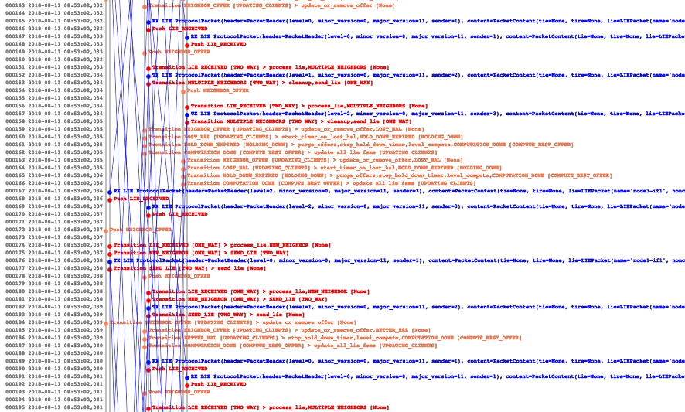
Real life example: early draft of RIFT

Slide 82
Network oscillation due to Run-away feedback loop

Slide 83
Shortest path routing, bandwidth metrics
Congested router
High queueing delay, packet drops

Slide 84
Desired situation: spread the load
This is what traffic engineering would do.

Slide 85
Failed attempts at congestion-sensitive routing
Congestion => Advertise high delay metric
No congestion => Advertise low delay metric

Slide 86
Failed attempts at congestion-sensitive routing
No congestion => Advertise low delay metric
Congestion => Advertise high delay metric

Slide 87
Oscillation due to unstable feedback loop
Northern path
Southern path
Traffic volume
Time
Delay-based metrics have been attempted many times, and have failed as many times

Slide 88
Take-aways for quantum control protocols
Make sure your protocols don’t have run-away scenarios
Beware of run-away replication
Beware of run-away state machines
Beware of run-away feedback loops

Slide 89
Thank you.

